Slide 1
Decentralized applications
CHIRAG S
4SN22AD019

Slide 2
All the ideas mentioned up to this point come under the broader umbrella of decentralized applications, abbreviated to DApps. DAOs, DACs, and DOs are DApps that run on top of a blockchain in a peer-to-peer network. They represent the latest advancement in decentralization technology.
DApps at a fundamental level are software programs that execute using either of the following methods. They are categorized as Type 1, Type 2, or Type 3 DApps:

Slide 3
Types of DApps
1
Type 1
Run on their own dedicated blockchain, for example, standard smart contract based DApps running on Ethereum. If required, they make use of a native token, for example, ETH on Ethereum blockchain.
2
Type 2
Use an existing established blockchain. that is, make use of Type 1 blockchain and bear custom protocols and tokens, for example, smart contract based tokenization DApps running Ethereum blockchain.
3
Type 3
Use the protocols of Type 2 DApps; for example, the SAFE Network uses the OMNI network protocol.
For example, Ethlance is a DApp that makes use of ETH to provide a job market.
More information about Ethlance can be found at https://ethlance.com.

Slide 4
Understanding DApp Types Through Examples
USDT Token Example
Current DApp Landscape
In the last few years, the expression DApp has been increasingly used to refer to any end-to-end decentralized blockchain application, including a user interface (usually a web interface), smart contract(s), and the host blockchain. The clear distinction between different types of DApps is now not commonly referred to, but it does exist. Often, DApps are now considered just as apps (blockchain apps) running on a blockchain such as Ethereum, Tezos, NEO, or EOS without any particular reference to their type.
Another example to understand the difference between different types of DApps is the USDT token (Tethers). The original USDT uses the OMNI layer (a Type 2 DApp) on top of the Bitcoin network. USDT is also available on Ethereum using ERC20 tokens. This example shows that a USDT can be considered a Type 3 DApp, where the OMNI layer protocol (a Type 2 DApp) is used, which is itself built on Bitcoin (a Type 1 DApp). Also, from an Ethereum point of view USDT can also be considered a Type 3 DApp in that it makes use of the Type 1 DApp Ethereum blockchain using the ERC 20 standard, which was built to operate on Ethereum.

Slide 5
Requirements of a DApp
Open Source & Autonomous
Decentralized Storage
The DApp should be fully open source and autonomous, and no single entity should be in control of a majority of its tokens. All changes to the application must be consensus driven based on the feedback given by the community.
Data and records of operations of the application must be cryptographically secured and stored on a public, decentralized blockchain to avoid any central points of failure.
Cryptographic Tokens
Token Generation
The tokens (if applicable) must be generated by the decentralized application using consensus and an applicable cryptographic algorithm. This generation of tokens acts as a proof of the value to contributors (for example, miners).
A cryptographic token must be used by the application to provide access for and incentivize those who contribute value to the applications, for example, miners in Bitcoin.

Slide 6






Operations of a DApp
Proven Security
So far, only PoW has been found to be incredibly resistant to attacks, as is evident from the success of and trust people have put in the Bitcoin network.
Consensus Algorithms
Establishment of consensus by a DApp can be achieved using consensus algorithms such as PoW and Proof of Stake (PoS).
Token Distribution
A DApp can distribute tokens (coins) via mining, fundraising, and development.

Slide 7
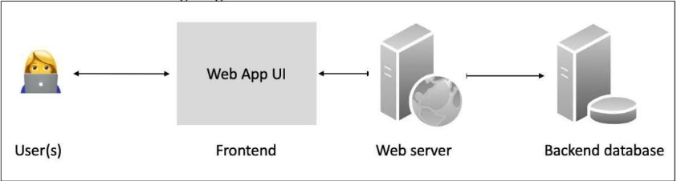
Design of a DApp
Traditional App Architecture
Traditional apps commonly consist of a user interface and usually a web server or an application server and a backend database. This is a common client/server architecture.
Figure 2.7: Traditional application architecture (generic client/server)

Slide 8
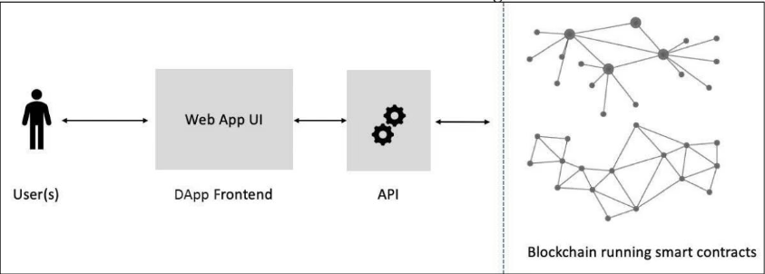
DApp Architecture
A DApp on the other hand has a blockchain as a backend. The key element that plays a vital role in the creation of a DApp is a smart contract that runs on the blockchain and has business logic embedded within it.
Figure 2.8: Generic DApp architecture

Slide 9
Comparison of Decentralized Entities
Entity
Autonomous?
Software?
Owned?
Capital?
Legal status
Cost
DO
No
No
Yes
Yes
Yes
High
DAO
Yes
Yes
No
Yes
Unsettled
Low
DAC
Yes
Yes
Yes
Yes
Unsettled
Low
DAS
Yes
Yes
No
Possible
Unsettled
Low
DApp
Yes
Yes
Yes
Optional tokens
Unsettled
Use case dependent

Slide 10



DApp Examples
Discover DApps
Having covered the main concepts of DApps, it will be useful to explore some specific examples.
Learn From Real Applications
Examples of some DApps are provided here.
Understand Implementation
Each example demonstrates different use cases for decentralized applications.

Slide 11
DApp Examples: KYC-Chain and OpenBazaar
KYC-Chain
OpenBazaar
This application provides the facility to manage Know Your Customer (KYC) data securely and conveniently based on smart contracts.
This is a decentralized peer-to-peer network that enables commercial activities directly between sellers and buyers instead of relying on a central party, such as eBay or Amazon. It should be noted that this system is not built on top of a blockchain; instead, distributed hash tables are used in a peer-to-peer network to enable direct communication and data sharing among peers.

Slide 12
DApp Example: Lazooz
Decentralized Ride Sharing
This is the decentralized equivalent of Uber. It allows peer-to-peer ride sharing and users to be incentivized by proof of movement, and they can earn Zooz coins.
More information on Lazooz is available at http://lazooz.org.
Many other DApps have been built on the Ethereum blockchain and are showcased
at http://dapps.ethercasts.com/.
Now that we have covered the pertinent terminology, DApps, and relevant examples, let's now look at what platforms can be used to build and host DApps.

Slide 13
THANK YOU!!

